Slide 1
UNIT-III
Logit transform
Tests of hypotheses
Wald test
LR test
score test
test for overall regression

Slide 2
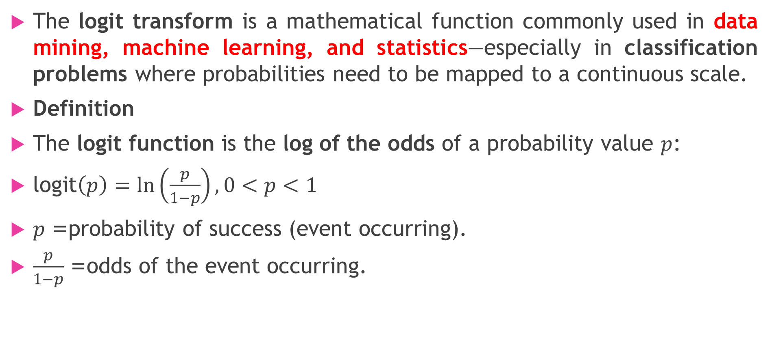
logit transform
The logit transform is a mathematical function commonly used in data mining, machine learning, and statistics—especially in classification problems where probabilities need to be mapped to a continuous scale.
Definition
The logit function is the log of the odds of a probability value $p$:
$\text{logit}\left(p\right)=\ln\left(\frac{p}{1−p}\right), 0<p<1$
$p$= probability of success (event occurring).
$\frac{p}{1−p}$= odds of the event occurring.

Slide 3
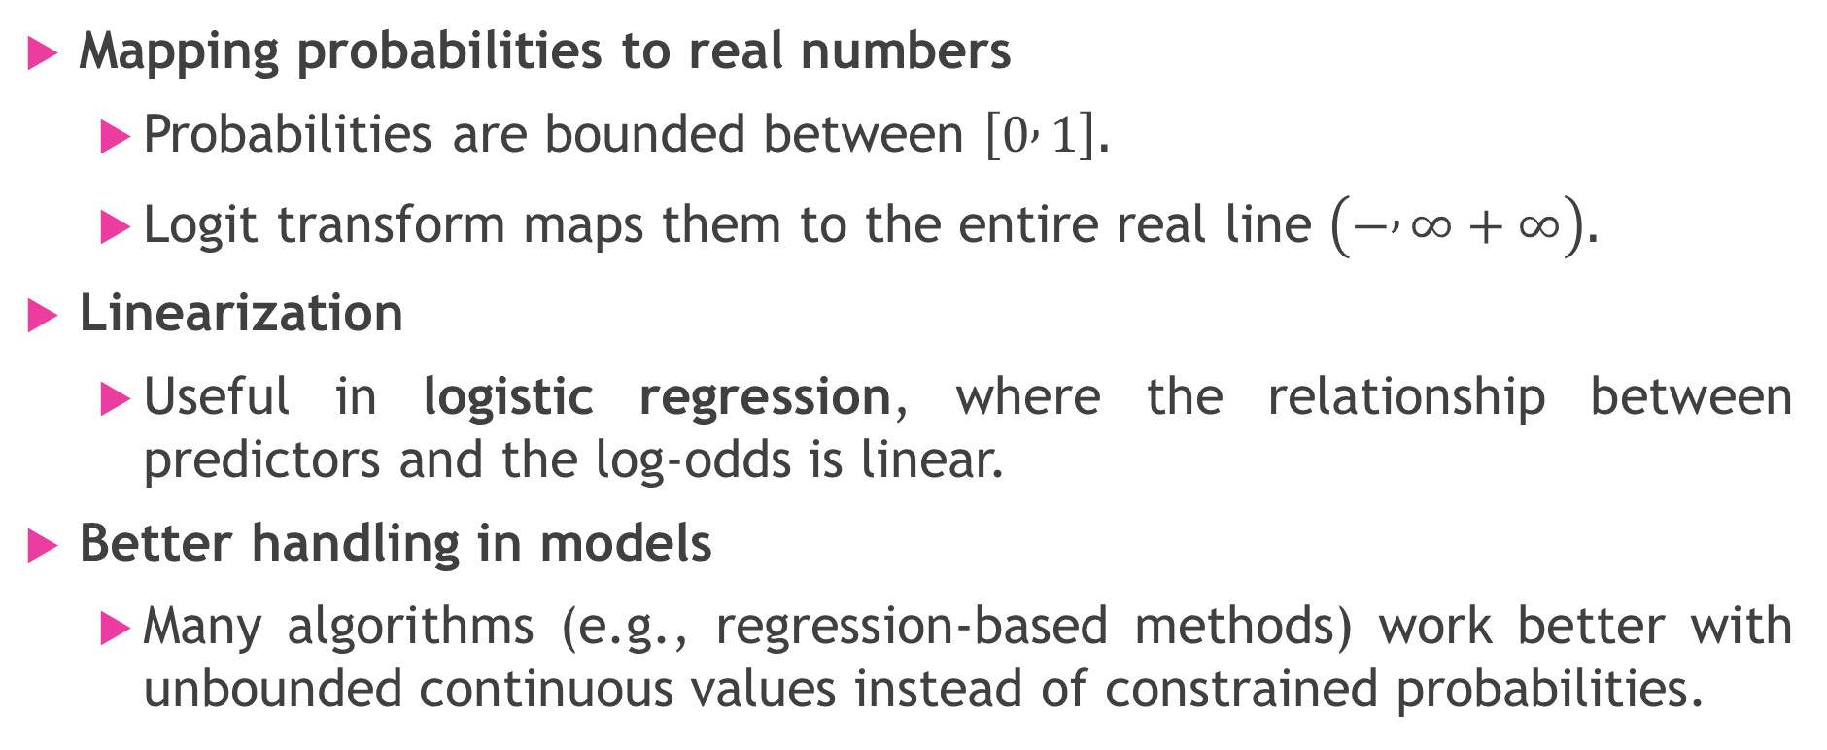
Why Use Logit Transform?
Mapping probabilities to real numbers
  Probabilities are bounded between $\left[0 , 1\right]$.
  Logit transform maps them to the entire real line $\left(− , ∞+∞\right)$.
Linearization
  Useful in logistic regression, where the relationship between predictors and the log-odds is linear.
Better handling in models
  Many algorithms (e.g., regression-based methods) work better with unbounded continuous values instead of constrained probabilities.

Slide 4
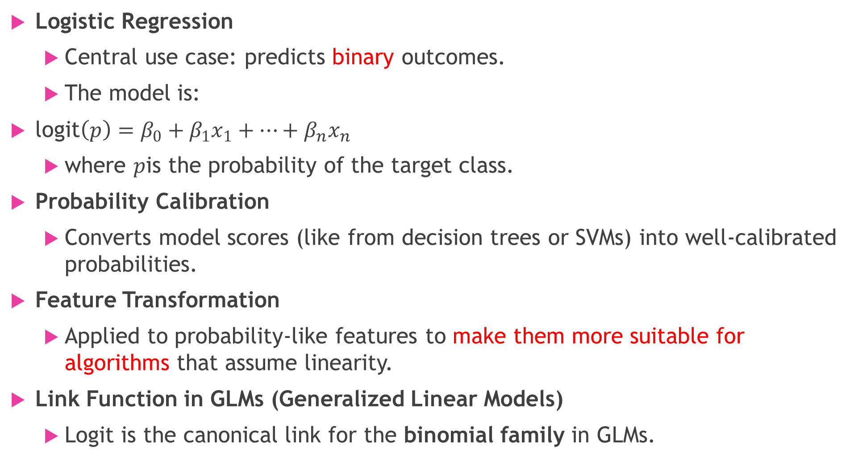
Applications in Data Mining
Logistic Regression
  Central use case: predicts binary outcomes.
  The model is:
$\text{logit}\left(p\right)=β_{0}+β_{1}x_{1}+⋯+β_{n}x_{n}$
  where $p$is the probability of the target class.
Probability Calibration
  Converts model scores (like from decision trees or SVMs) into well-calibrated probabilities.
Feature Transformation
  Applied to probability-like features to make them more suitable for algorithms that assume linearity.
Link Function in GLMs (Generalized Linear Models)
  Logit is the canonical link for the binomial family in GLMs.

Slide 5
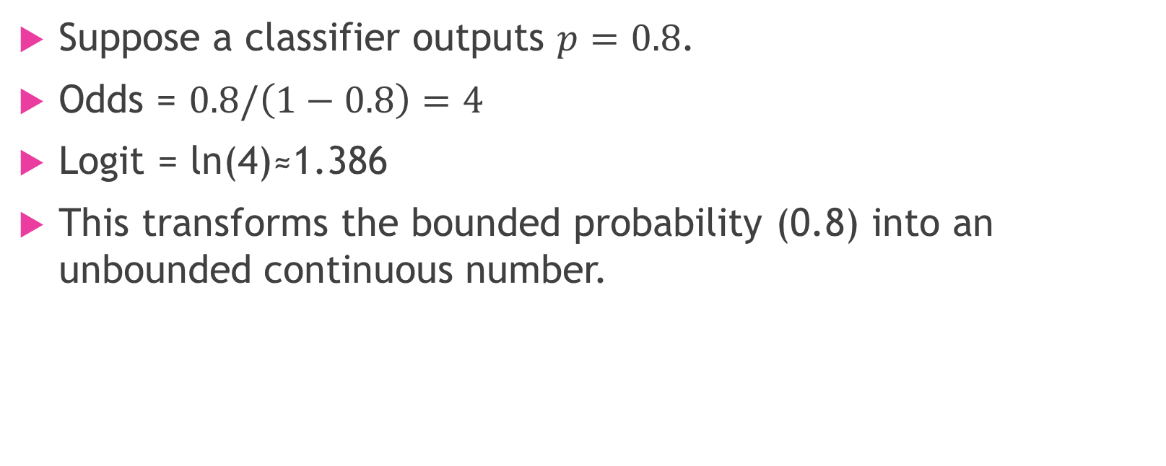
Example
Suppose a classifier outputs $p=0.8$.
Odds = $0.8/\left(1−0.8\right)=4$
Logit = ln⁡(4)≈1.386
This transforms the bounded probability (0.8) into an unbounded continuous number.

Slide 6

Hypothesis Testing in Regression
We often test hypotheses of the form:
$H_{0}:θ=θ_{0} \text{vs}\text{.} H_{1}:θ≠θ_{0}$
where $θ$could be a single parameter (e.g., coefficient) or a set of parameters.

Slide 7
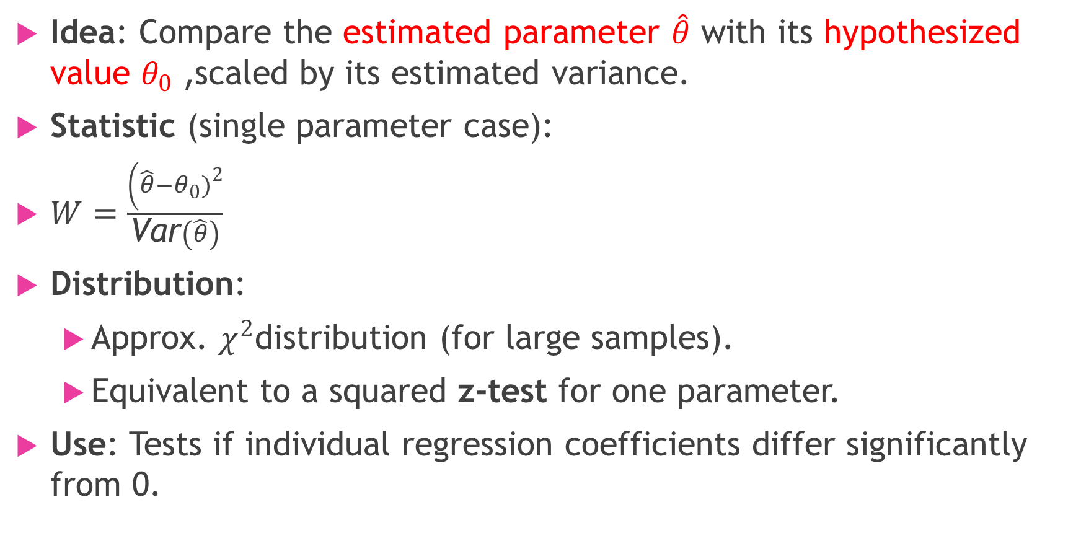
Wald Test
Idea: Compare the estimated parameter $\hat{θ}$ with its hypothesized value $θ_{0}$, scaled by its estimated variance.
Statistic (single parameter case):
$W=\frac{\left(\hat{θ}−θ_{0}{\left.)\right.}^{2}\right.}{\text{Var}\left(\hat{θ}\right)}$
Distribution:
  Approx. $χ^{2}$distribution (for large samples).
  Equivalent to a squared z-test for one parameter.
Use: Tests if individual regression coefficients differ significantly from 0.

Slide 8
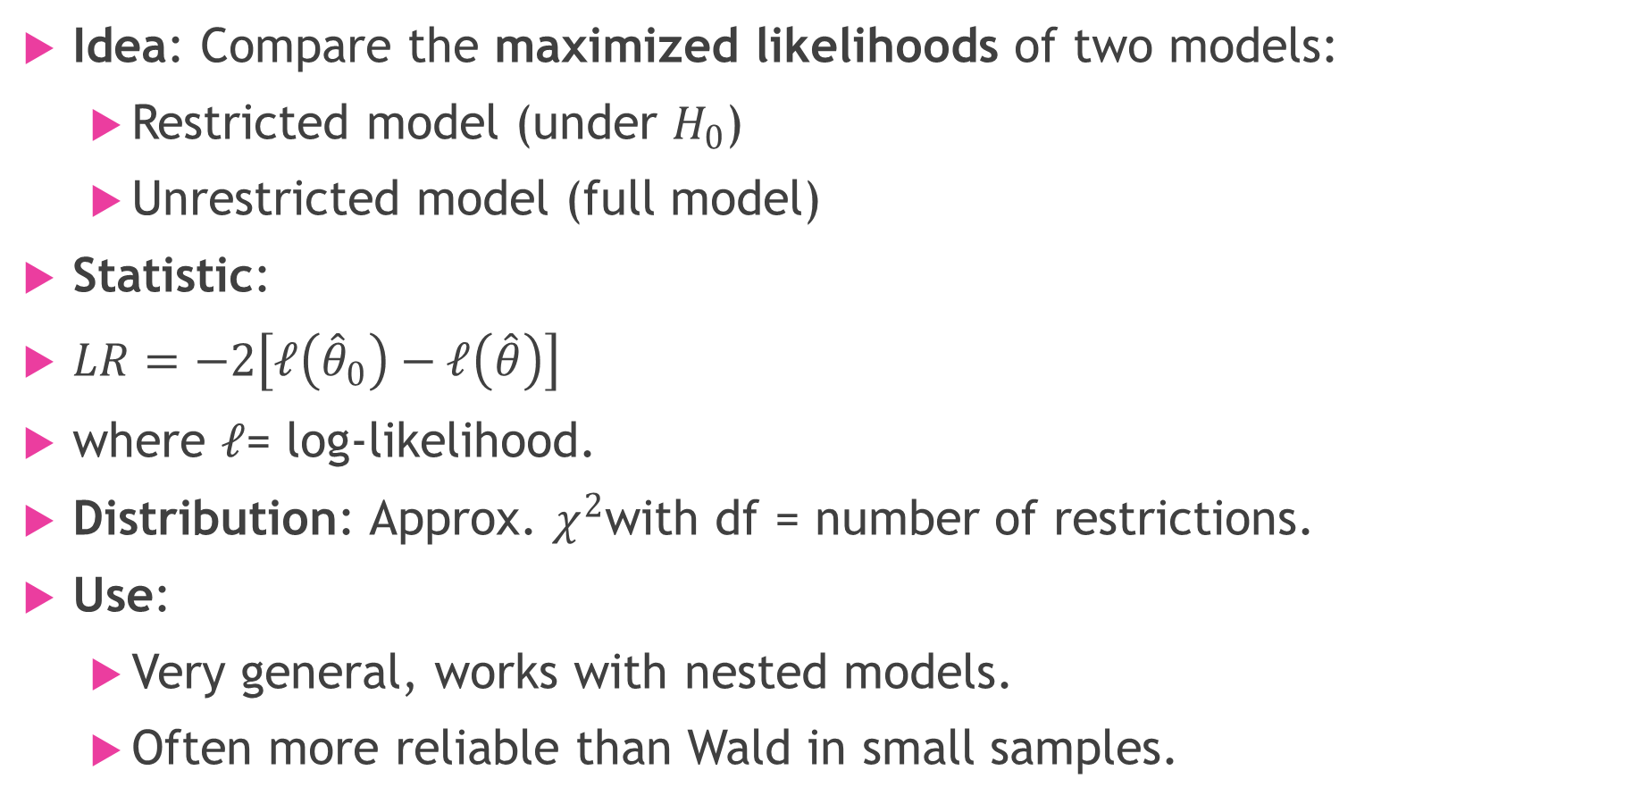
Likelihood Ratio (LR) Test
Idea: Compare the maximized likelihoods of two models:
  Restricted model (under $H_{0}$)
  Unrestricted model (full model)
Statistic:
$LR=−2\left[ℓ\left({\hat{θ}}_{0}\right)−ℓ\left(\hat{θ}\right)\right]$
where $ℓ$= log-likelihood.
Distribution: Approx. $χ^{2}$with df = number of restrictions.
Use:
  Very general, works with nested models.
  Often more reliable than Wald in small samples.

Slide 9
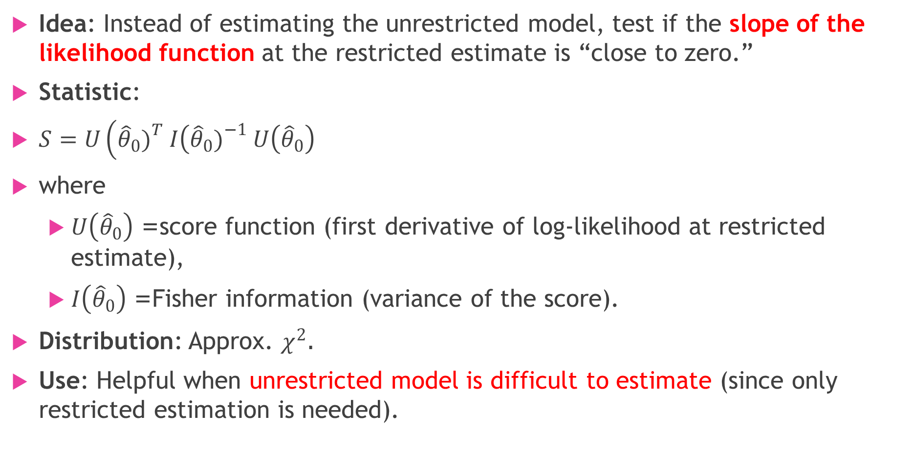
Score Test (Lagrange Multiplier Test)
Idea: Instead of estimating the unrestricted model, test if the slope of the likelihood function at the restricted estimate is “close to zero.”
Statistic:
$S=U\left({\hat{θ}}_{0}{\left.)\right.}^{T} I\left({\hat{θ}}_{0}{\left.)\right.}^{−1} U\left({\hat{θ}}_{0}\right)\right.\right.$
where
  $U\left({\hat{θ}}_{0}\right)$= score function (first derivative of log-likelihood at restricted estimate),
  $I\left({\hat{θ}}_{0}\right)$= Fisher information (variance of the score).
Distribution: Approx. $χ^{2}$.
Use: Helpful when unrestricted model is difficult to estimate (since only restricted estimation is needed).

Slide 10
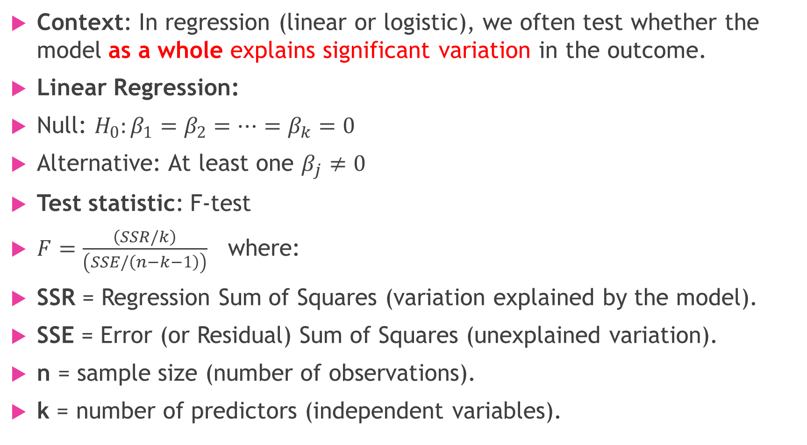
Test for Overall Regression
Context: In regression (linear or logistic), we often test whether the model as a whole explains significant variation in the outcome.
Linear Regression:
Null: $H_{0}:β_{1}=β_{2}=⋯=β_{k}=0$
Alternative: At least one $β_{j}≠0$
Test statistic: F-test
$F=\frac{\left(SSR/k\right)}{\left(SSE/\left(n−k−1\right)\right)}$ where:
SSR = Regression Sum of Squares (variation explained by the model).
SSE = Error (or Residual) Sum of Squares (unexplained variation).
n = sample size (number of observations).
k = number of predictors (independent variables).

Slide 11
Logistic Regression / GLMs:
Equivalent tests:
  Likelihood Ratio Test (compare full vs intercept-only model)
  Score Test (test slope at intercept-only model)
  Wald Test (joint test of coefficients)

Slide 12
🔹 Comparison of the Three Tests
Test | Needs unrestricted model? | Reliability | Notes
Wald | Yes | Sometimes poor in small samples | Easy to compute, widely used
LR | Yes | Generally most reliable | Compares fits of full vs restricted
Score | No (only restricted model needed) | Good for nested model checks | Useful when unrestricted estimation is hard

Slide 13
Summary
Wald: Test if estimated coefficients differ from hypothesized values.
LR: Compare likelihoods of restricted vs unrestricted models.
Score: Check slope of likelihood at restricted estimates.
Overall regression test: F-test in linear regression, LR/Score/Wald in logistic or GLM settings.

